Slide 1


Git Commands
Sijumary Johnson

Slide 2
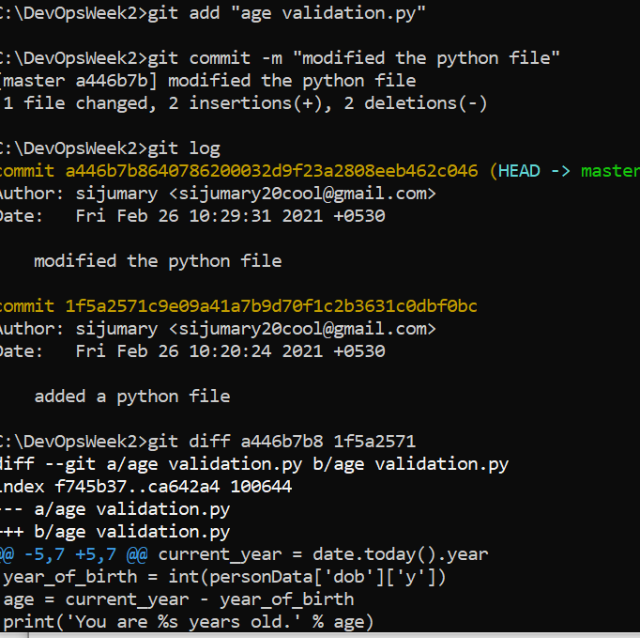
(Screenshots) git log command

Slide 3
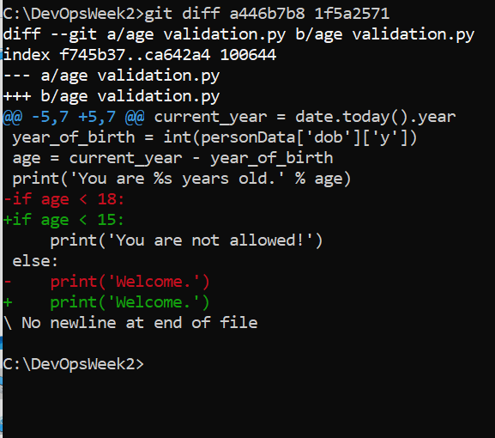
Git diff command

Slide 4
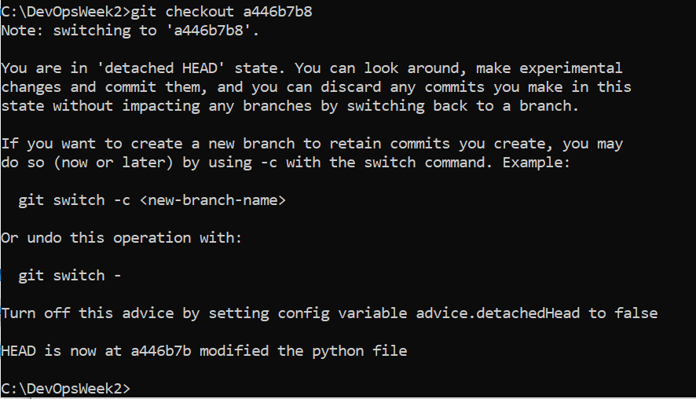
Git checkout command

Slide 5
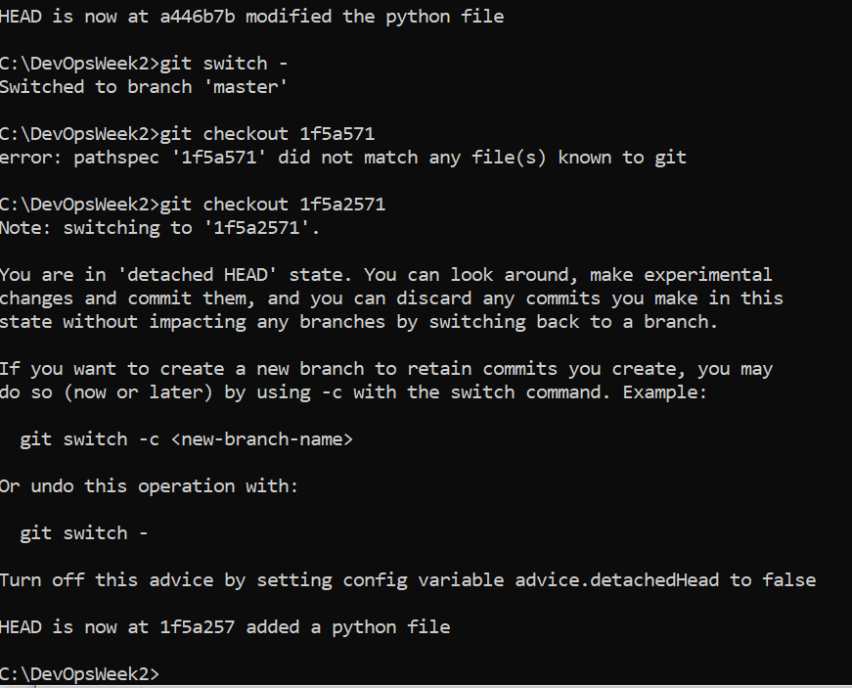
Git checkout command

Slide 6
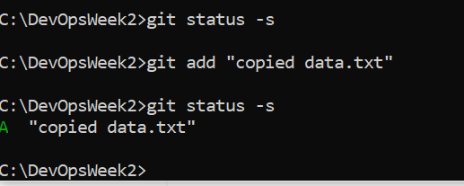
Git status command

Slide 7
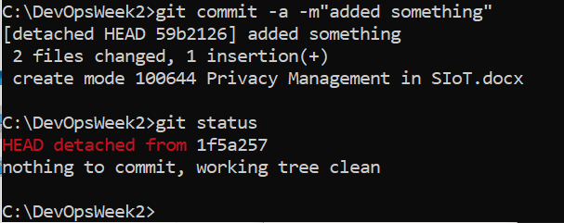
Git commit –a –m command

